Slide 1

Jose Annunziato

Slide 2
Non Relational Databases
NoSQL databases are an alternative to Relational databases. Don't use SQL
Several NoSQL databases: MongoDB, Cassandra, CouchDB, Redis, DynamoDB, Firebase
Other types of NoSQL databases: Object, Document, Graph, Real Time

Slide 3
Non Relational Databases
Graph databases deal with highly interconnected data where the database consists of nodes and relationships between them, e.g., Neo4J
Real time databases handle workloads whose state is constantly changing, e.g., Firebase

Slide 4
Download MongoDB
MongoDB's main Website
Download free community database server from
https://www.mongodb.com/
https://www.mongodb.com/try/download/community

Slide 5
Install MongoDB
On macOS
untar download to /usr/local/
e.g., /usr/local/mongodb-macos-x86_64-4.4.1/
add /usr/local/mongodb-macos-x86_64-4.4.1/bin/ to PATH environment variable
On Windows
untar download to C:/Program Files
e.g., C:/Program Files/mongodb-windows86_64-4.4.1/
add C:/Program Files/mongodb-windows86_64-4.4.1/bin to PATH environment variable

Slide 6
On a Mac
Edit ~/.bash_profile
Append path to $PATH variable
Example:
export PATH="$PATH:/usr/local/mongodb-macos-x86_64-4.4.4/bin"

Slide 7
Create a Data Directory
MongoDB needs a directory to store data
Typically located at the root
On macOS you might need to use sudo
If you don't have permission, provide path at startup (later)
> mkdir /data
> mkdir /data/db
> sudo mkdir /data
> mkdir /data/db

Slide 8
Use mongod to Start Database Server
From the command line, use mongod to start the database server
On macOS, you might need to use sudo
> sudo mongod

Slide 9
Specify Data Directory
You can specify the data path when you start the database server using the --dbpath option
If you don't have permission to create the /data/db path at the root of your file system, then use this technique to provide another path of your choice
> mkdir myDbPath
> mongod --dbpath myDbPath

Slide 10
mongod Server Listens at Port 27017
MongoDB starting : pid=9062 port=27017 dbpath=/data/db 64-bit host=Joses-MBP.home
db version v3.4.7
git version: cf38c1b8a0a8dca4a11737581beafef4fe120bcd
OpenSSL version: OpenSSL 0.9.8zh 14 Jan 2016
allocator: system
modules: none
build environment:
distarch: x86_64
target_arch: x86_64
options: {}
- Detected data files in /data/db created by the 'wiredTiger' storage engine, so setting the active storage engine to 'wiredTiger'.
...
NETWORK [thread1] waiting for connections on port 27017

Slide 11
MONGO CLIENT

Slide 12
Use mongo to connect to database
From the command line, use mongo to connect to the database server
> mongo
MongoDB shell version v3.4.7
connecting to: mongodb://127.0.0.1:27017
MongoDB server version: 3.4.7
...
>

Slide 13
List databases
From mongo command line interface (CLI), use show db to list the databases
> show dbs
admin 0.000GB
cs4500 0.000GB
cs3200 0.000GB
cs5610 0.000GB
f360 0.000GB
local 0.000GB
test 0.000GB
>

Slide 14
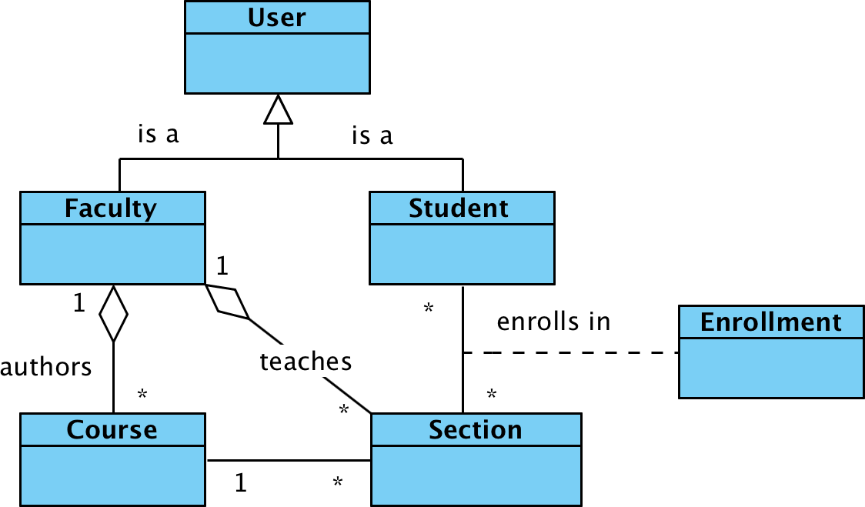
Consider the following model

Slide 15
Create a database
Create a database using the use command
All subsequent commands will be relative to the current database in use
> use db_design
switched to db db_design
>

Slide 16
Working with collections
All commands that manipulate data start with db followed by the collection name, e.g.:
Commands include:
insert()
find()
update()
remove()
> db.<collection>.<command>(<data>)

Slide 17
Inserting data
Use the insert() command to insert data into a collection. Data is formatted as JSON objects
Inserting user object into users collection
Inserting data creates collection if none existent
> db.users.insert({
username: 'ada',
firstName: 'Ada',
lastName: 'Lovelace'});

Slide 18
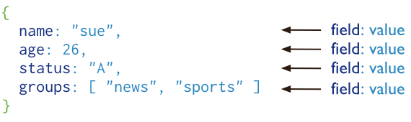
MongoDB documents

Slide 19
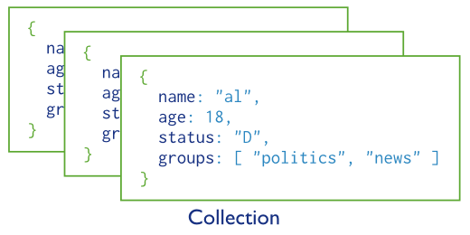
MongoDB collections

Slide 20
Listing collections
Use the show collections to list existing collections
> show collections
users

Slide 21
Querying documents
Use the find() command to query documents from a collection
Mongo adds unique identifier field _id
> db.users.find()
{ "_id" : ObjectId("5aa5ab73ab319d0f94089fc7"), "username" : "ada", "firstName" : "Ada", "lastName" : "Lovelace" }

Slide 22
Pretty print queries
Use the pretty() command to pretty print queries
> db.users.find().pretty()
{
"_id" : ObjectId("5aa5ab73...4089fc7"),
"username" : "ada",
"firstName" : "Ada",
"lastName" : "Lovelace"
}

Slide 23
Find document by Id
First parameter filters documents
Use ObjecId to filter by primary key _id
> db.users.find(
{_id: ObjectId('5aa5ab73ab319d0f94089fc7')});
{
"_id" : ObjectId("5aa5ab73ab319d0f94089fc7"),
"username" : "ada",
"firstName" : "Ada",
"lastName" : "Lovelace"
}

Slide 24
Find document by non key fields
find() matches all fields in first parameter
> db.users.find({username: 'ada'})
{
"_id" : ObjectId("5aa5ab73ab319d0f94089fc7"),
"username" : "ada",
"firstName" : "Ada",
"lastName" : "Lovelace"
}

Slide 25
Select fields
Second parameter selects fields
> db.users.find(
{username: 'ada'},
{lastName: 1});
{
"_id" : ObjectId("5aa5ab73ab319d0f..."),
"lastName" : "Lovelace"
}

Slide 26
Consider the following model

Slide 27
Insert more data
Let's create several sections
> db.sections.insert({name: '01', seats: 12, course: 'cs101'})
> db.sections.insert({name: '02', seats: 23, course: 'cs101'})
> db.sections.insert({name: '03', seats: 34, course: 'cs102'})
> db.sections.insert({name: '04',
seats: 45, course: 'cs102'})

Slide 28
Filter data with predicates
db.sections.find({course: 'cs101'}).pretty()
{
"_id" : ObjectId("5aa5bd55ab319d0f..."),
"section" : "01",
"seats" : 12,
"course" : "cs101"
}
{
"_id" : ObjectId("5aa5bd55ab319d0f..."),
"section" : "02",
"seats" : 23,
"course" : "cs101"
}

Slide 29
Narrow down query
Add additional fields to query to narrow down matching documents
> db.sections.find({
course: 'cs101',
seats: 12});
{
"_id" : ObjectId("5aa5bd55ab319d0f..."),
"section" : "01",
"seats" : 12,
"course" : "cs101"
}

Slide 30
Greater and less than
Use $gt and $lt to filter documents
> db.sections.find({seats: {$gt: 30}}).pretty()
{
"_id" : ObjectId("5aa5b7cca...4089fd1"),
"section" : "03",
"seats" : 34
}
{
"_id" : ObjectId("5aa5b7d2...94089fd2"),
"section" : "04",
"seats" : 45
}

Slide 31
Use $and to combine predicates
> db.sections.find({
$and: [
{seats: {$gt: 30}},
{seats: {$lt: 40}}
]}).pretty()
{
"_id" : ObjectId("5aa5bd55ab319d0f..."),
"section" : "03",
"seats" : 34,
"course" : "cs102"
}

Slide 32
Use sort() to sort query results
Sort ascending modifies query ordering
Sort descending modifies query ordering
> db.sections.find().sort({seats: 1})
{ "section" : "01", "seats" : 12}
{ "section" : "03", "seats" : 34}
{ "section" : "04", "seats" : 45}
> db.sections.find().sort({seats: -1})
{ "section" : "04", "seats" : 45}
{ "section" : "03", "seats" : 34}
{ "section" : "01", "seats" : 12}

Slide 33
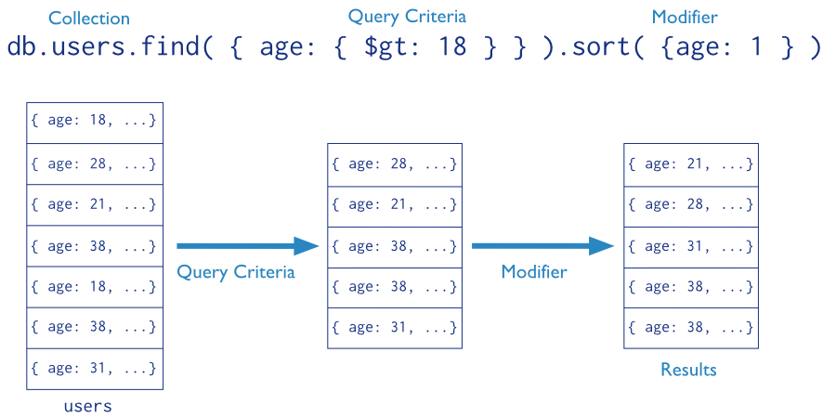
Finding and filtering collections

Slide 34
Comparison query selectors
Name | Description
$eq | Matches values that are equal to a specified value.
$gt | Matches values that are greater than a specified value.
$gte | Matches values that are greater than or equal to a specified value.
$in | Matches any of the values specified in an array.
$lt | Matches values that are less than a specified value.
$lte | Matches values that are less than or equal to a specified value.
$ne | Matches all values that are not equal to a specified value.
$nin | Matches none of the values specified in an array.

Slide 35
Logical query selectors
https://docs.mongodb.com/manual/reference/operator/query/
Name | Description
$and | Joins query clauses with a logical AND returns all documents that match the conditions of both clauses.
$not | Inverts the effect of a query expression and returns documents that do not match the query expression.
$nor | Joins query clauses with a logical NOR returns all documents that fail to match both clauses.
$or | Joins query clauses with a logical OR returns all documents that match the conditions of either clause.

Slide 36
Aggregation operators
https://docs.mongodb.com/manual/reference/operator/aggregation-pipeline/
Name | Description
$count | Returns a count of the number of documents at this stage of the aggregation pipeline.
$group | Groups input documents by a specified identifier expression and applies the accumulator expression(s), if specified, to each group.
$limit | Passes the first n documents unmodified to the pipeline where n is the specified limit. For each input document, outputs either one document
$skip | Skips the first n documents where n is the specified skip number and passes the remaining documents unmodified to the pipeline.

Slide 37
Updating documents
Use update() command to update existing documents
> db.sections.find({name: '02'}, {seats: 1})
{ "_id" : ObjectId("5aa5b..."), "seats" : 23 }
> db.section.update({name: '02'},
{seats: 22}) -- careful
> db.section.update({name: '02'},
{$set: {seats: 22}})
WriteResult({"nMatched" : 1,"nModified" : 1})
> db.sections.find({name: '02'}, {seats: 1})
{ "_id" : ObjectId("5aa5b..."), "seats" : 22 }

Slide 38
Deleting documents
Use remove() command to delete existing documents
Checkout documentation for all operations https://docs.mongodb.com/manual/crud/
> db.sections.remove({name: '02'})
WriteResult({ "nRemoved" : 1 })

Slide 39
Insert commands
Name | Description
db.collection.insertOne() | Inserts a single document into a collection.
db.collection.insertMany() | db.collection.insertMany() inserts multiple documents into a collection.
db.collection.insert() | db.collection.insert() inserts a single document or multiple documents into a collection.

Slide 40
Update commands
Name | Description
db.collection.updateOne() | Updates at most a single document that match a specified filter even though multiple documents may match the specified filter.
db.collection.updateMany() | Update all documents that match a specified filter.
db.collection.replaceOne() | Replaces at most a single document that match a specified filter even though multiple documents may match the specified filter.
db.collection.update() | Either updates or replaces a single document that match a specified filter or updates all documents that match a specified filter.

Slide 41
Delete commands
Name | Description
db.collection.deleteOne() | Delete at most a single document that match a specified filter even though multiple documents may match the specified filter.
db.collection.deleteMany() | Delete all documents that match a specified filter.
db.collection.remove() | Delete a single document or all documents that match a specified filter.
db.collection.deleteOne() | Delete at most a single document that match a specified filter even though multiple documents may match the specified filter.

Slide 42
INHERITANCE/ GENERALIZATIONS
Dr. Jose Annunziato

Slide 43
Consider the following model

Slide 44
Modeling Generalization
Model generalizations by flattening hierarchy and adding a type property, aka denormalized strategy
Creating faculties
Retrieving faculties
> db.users.update({username: 'ada'},
{$set: {type: 'FACULTY', office: '132A'}});
> db.users.insert({username: 'tlee', type:
'FACULTY', office: '133B'})
> db.users.find({type: 'FACULTY'})

Slide 45
Modeling Generalization
Creating students
Retrieving students
> db.users.insert({username: 'john',
gpa: 3.8, type: 'STUDENT'})
> db.users.insert({username: 'jane',
type: 'STUDENT'})
> db.users.update({username: 'jane'},
{$set: { gpa: 3.9}})
> db.users.find({type: 'STUDENT'})

Slide 46
MANY TO MANY
Dr. Jose Annunziato

Slide 47
Consider the following model

Slide 48
Modeling Many to Many
There are several ways of modeling many to many
Using a map: Enrollment
enrollment1.section = section1._id
enrollment1.student = student1._id
Using arrays of foreign keys
student1.sections = [ section1._id, section2._id, ... ]
section1.students = [ student1._id, student2._id, ... ]

Slide 49
Modeling Many to Many using maps
students
student1
student2
student3
student4
enrollments
student1 | section1
student2 | section1
student3 | section3
student3 | section4
sections
section1
section2
section3
section4

Slide 50
Modeling Many to Many using maps
Creating enrollments
Alternatively, students and sections can reference each other with arrays of identifiers
> db.enrollments.insert({
section: '5aa5bd55ab319d0f94089fd3',
student: '5aa9515ad982cb8e72af70ce'
})

Slide 51
Modeling Many to Many with arrays
students
name | sections
student1 | [section1]
student2 | [section1]
student3 | [section3, section4]
student4 | [ ]
sections
students | name
[student1, student2] | section1
[ ] | section2
[student3] | section3
[student3] | section4

Slide 52
Modeling Many to Many with arrays
students
name | sections
student1 | [section1]
student2 | [section1]
student3 | [section3, section4]
student4 | [ ]
sections
students | name
[student1, student2] | section1
[ ] | section2
[student3] | section3
[student3] | section4

Slide 53
Modeling Many to Many with arrays
Students reference array of enrolled sections
> db.students.update({
_id: ObjectId('5aa95148d982cb8e72af70cd')},
{$set: {sections:
['5aa5bd55ab319d0f94089fd3']}})
> db.students.update({
_id: ObjectId('5aa95148d982cb8e72af70cd')},
{$push: {sections:
'5aa9515ad982cb8e72af70f4'}})

Slide 54
Modeling Many to Many with arrays
Sections reference array of enrolled students
> db.sections.update({
_id: ObjectId('5aa5bd55ab319d0f94089fd3')},
{$set: {students:
['5aa95148d982cb8e72af70cd']}})
> db.sections.update({
_id: ObjectId('5aa5bd55ab319d0f94089fd3')},
{$push: {students:
'5aa9515ad982cb8e72af70ce'}})

Slide 55
ONE TO MANY
Dr. Jose Annunziato

Slide 56
Consider the following model

Slide 57
Modeling One to Many
There are three ways of modeling one to many
Child references parent (classical)
sections.facultyId = faculty._id
courses.authorId = faculty._id
Parent arrays of child foreign keys
faculties.sectionsTaught = [ section1._id, section2._id, ... ]
faculties.coursesAuthored = [ course1._id, course2._id, ... ]
Parent arrays of embedded child object instances
faculties.sectionsTaught = [ section1, section2, ... ]
faculties.coursesAuthored = [ course1, course2, ... ]

Slide 58
Modeling One to Many w/ FK - normalized
faculties
faculty1
faculty2
faculty3
faculty4
sections
faculty | name
faculty2 | section1
faculty2 | section2
faculty3 | section3

Slide 59
Modeling One to Many w/ FK - normalized
faculties
faculty1
faculty2
faculty3
faculty4
sections
faculty | name
faculty2 | section1
faculty2 | section2
faculty3 | section3

Slide 60
Modeling One to Many w/ FK - normalized
Section references faculty
This is how relational databases generally model one to many relationships
> db.sections.update({
_id: ObjectId('5aa5bd55ab319d0f94089fd3')},
{$set: {
faculty: '5aa5ab73ab319d0f94089fc7'}
})

Slide 61
EMBEDDED
OBJECTS
Dr. Jose Annunziato

Slide 62
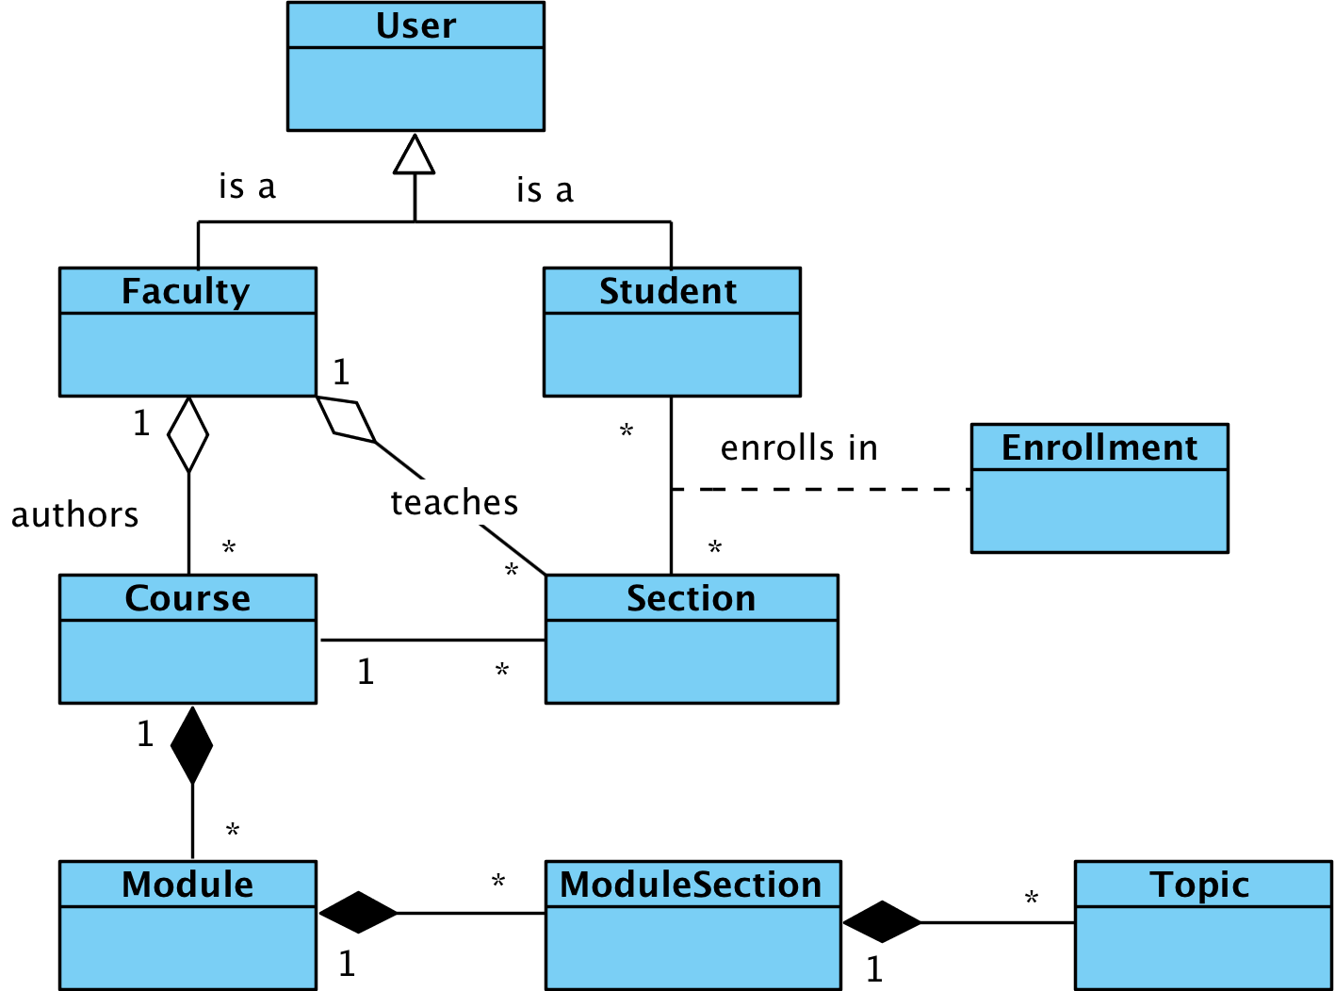
Consider the following model
Lesson

Slide 63
Embedding objects - denormalized
Embed object instances as properties of other objects
topic1, topic2
lesson1.topics =
[ topic1, topic2, ...]
module1.lessons =
[ lesson1, ...]
course1.modules =
[ module1, module2,...]
courses
course1
course2
modules
module1
module2
lessons
lesson1

Slide 64
Creating a module & embedded lesson
> db.modules.insert({name: 'module1',
lessons: [{name: 'lesson1'}]})
> db.modules.find().pretty()
{
"_id" : ObjectId("5aa96092d982cb8e7..."),
"name" : "module1",
"lessons" : [
{
"name" : "lesson1"
}
]
}

Slide 65
Adding an embedded lesson
> db.modules.update({name: 'module1'},
{$push: {lessons: {name: 'lesson2'}}});
> db.modules.find().pretty()
{
"_id" : ObjectId("5aa96092d982cb8e7..."),
"name" : "module1",
"lessons" : [
{ "name" : "lesson1" },
{ "name" : "lesson2" }
]
}

Slide 66
Retrieving embedded objects
> db.modules.find(
{name: 'module1'}, {lessons: 1})
{
"_id" : ObjectId("5aa96092d982cb8e72..."),
"lessons" : [
{ "name" : "lesson1" },
{ "name" : "lesson2" }
]
}

Slide 67
Adding objects to nested array
> db.modules.update({name: 'module1', 'lessons.name': 'lesson1'}, {$set: {'lessons.$.topics': [{name: 'topic1'}]}})
> db.modules.find().pretty()
{ "name" : "module1",
"lessons" : [
{ "name" : "lesson1",
"topics" : [
{"name": "topic1"}]
},
{ "name" : "lesson2" }]
}
The positional $ operator identifies an element in an array to update without explicitly specifying the position of the element in the array

Slide 68
POSITIONAL OPERATOR
Dr. Jose Annunziato

Slide 69
Create a course
> db.courses.insert({name: 'course1'})
> db.courses.find().pretty()
{
"_id" : ObjectId("5aa96463d982cb8e72a..."),
"name" : "course1"
}

Slide 70
Add an empty modules array
> db.courses.update({name: 'course1'},
{$set: {modules: []}});
> db.courses.find({name: 'course1'}).pretty();
{
"_id" : ObjectId("5aa96463d982cb8e72..."),
"name" : "course1",
"modules" : [ ]
}

Slide 71
Push an embedded module object
> db.courses.update({name: 'course1'},
{$push: {modules: {name: 'module1'}}});
> db.courses.find({name: 'course1'}).pretty();
{
"_id" : ObjectId("5aa96463d982cb8e72a..."),
"name" : "course1",
"modules" : [
{ "name" : "module1" }
]
}

Slide 72
Push another embedded module object
> db.courses.update({name: 'course1'},
{$push: {modules: {name: 'module2'}}});
> db.courses.find({name: 'course1'}).pretty();
{ "_id" : ObjectId("5aa96463d982cb8e72a..."),
"name" : "course1",
"modules" : [
{ "name" : "module1" },
{ "name" : "module2" }
]
}

Slide 73
Add a module section to the module
> db.courses.update({name: 'course1',
'modules.name': 'module1'}, {$set:
{'modules.$.lessons': [{name:'lesson1'}]}});
> db.courses.find({name: 'course1'}).pretty();
{ "name" : "course1",
"modules" : [
{ "name" : "module1",
"lessons" : [{"name" : "lesson1"}]
},
{ "name" : "module2" }
]
}

Slide 74
Add a topic to the section
> db.courses.update({name: 'course1', 'modules.name': 'module1', 'modules.lessons.name': 'lesson1'}, {$set: {'modules.$.lessons.$.topics': [{name: 'topic1'}]}});
Too many positional (i.e. '$') elements found in path 'modules.$.lessons.$.topics'

Slide 75
Add a topic to the section
> db.courses.update({name: 'course1', 'modules.name': 'module1', 'modules.lessons.name': 'lesson1'}, {$set: {'modules.$.lessons.0.topics': [{name: 'topic1'}]}});
> db.courses.find().pretty()
{ "name" : "course1",
"modules" : [{"name" : "module1",
"lessons" : [{"name" : "lesson1",
"topics" : [
{ "name" : "topic1" }]
}],...
}

Slide 76
References
http://www.mongodb.org
https://mongolab.com
http://mongoosejs.com

